Slide 1

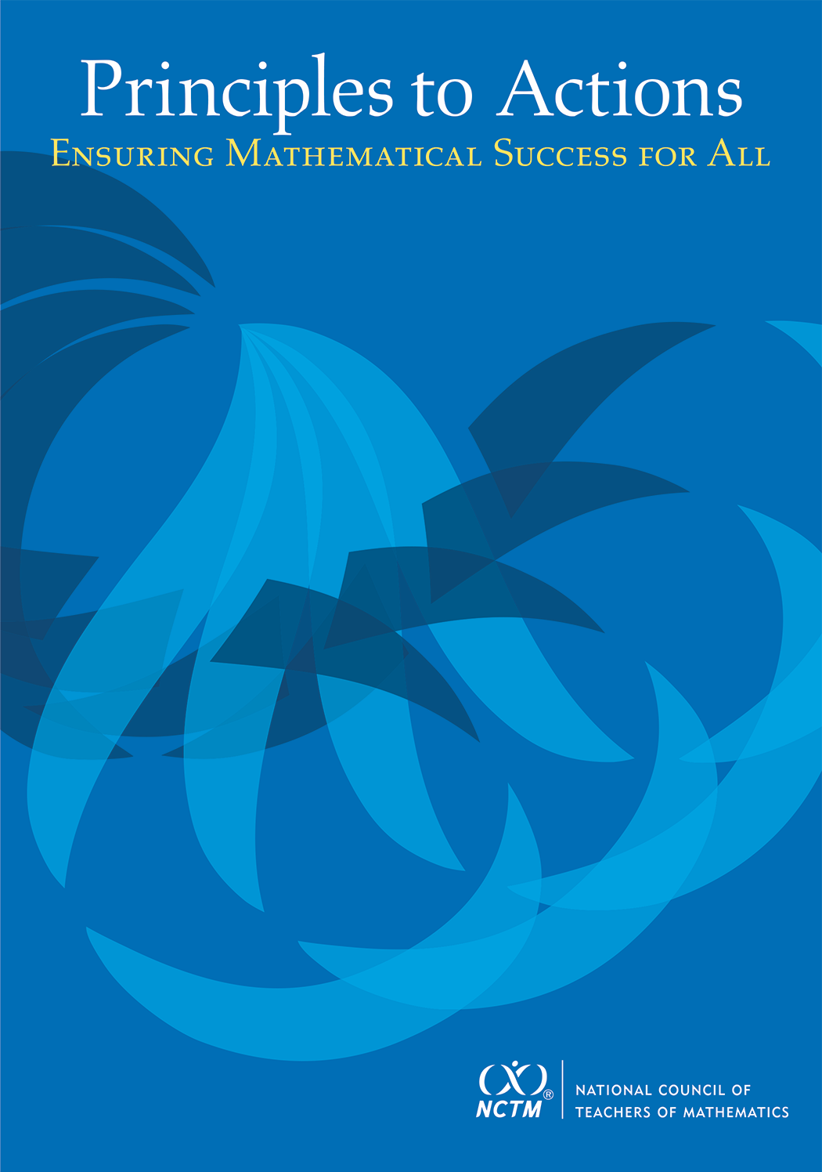
Engaging Tasks + Student Discussion = Math Success
Diane J. Briars
President
National Council of Teachers of Mathematics dbriars@nctm.org
SXSWedu
Austin, TX
March 7, 2016

Slide 2
FYI
Electronic copies of slides are available
by request
dbriars@nctm.org

Slide 3
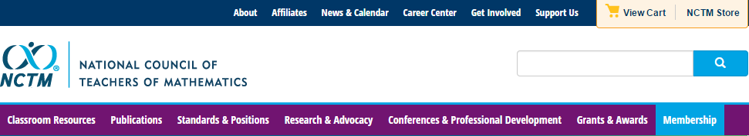
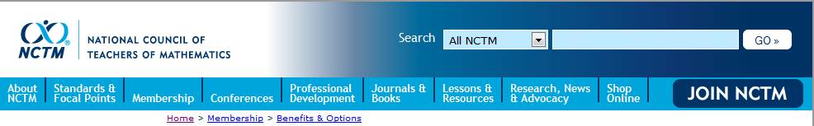

National Council of Teachers of Mathematics www.nctm.org

Slide 4



National Council of Teachers of Mathematics www.nctm.org
National Council of Teachers of Mathematics
www.nctm.org
For $144 per year, your school will get a FREE print-only subscription to one of the following award-winning journals:
Five FREE E-Memberships for teachers in your school
All the benefits of an e-membership including full access to
the digital edition of Teaching Children Mathematics or
Mathematics Teaching in the Middle School (a $72 value!) FREE!
To involve more teachers, additional e-memberships can be added
for just $10 each.

Slide 5
National Council of Teachers of Mathematics www.nctm.org
National Council of Teachers of Mathematics
www.nctm.org
New Member Discount
$20 off for full membership
$10 off e-membership
$5 off student membership
Use Code: BDB0616

Slide 6

NCTM Conferences www.nctm.org
  2016 Annual Meeting and Exposition
  April 13–16, 2016
  San Francisco

Slide 7
NCTM Interactive Institutes www.nctm.org
Engaging Students in Learning: Mathematical Practices, Grades K-8
July 11 – July 13, 2016, Atlanta, GA
Engaging Students in Learning: Mathematical Practices and Process Standards, High School
July 14 – July 16, 2016, Atlanta, GA
Algebra Readiness Institute, Grades 6-8
July 18-20, 2016, Denver, CO
Number and Operations Institute, Grades Pk-5
July 21-23, 2016, Denver CO

Slide 8
NCTM Regional Conferences www.nctm.org
Phoenix
October 26–28, 2016
Philadelphia, PA
October 31–November 2, 2016

Slide 9

NCTM Innov8
November 16-18, 2016, St. Louis
“Engaging the Struggling Learner”
Community. Collaboration. Solutions.
Bring your team and engage in a hands-on, interactive, and new
learning experience for mathematics education.
With a focus on “Engaging the
Struggling Learner,” become part
of a team environment and navigate
your experience through three
different pathways:
Response to Intervention (RtI)
Supporting productive struggle
Motivating the struggling learner
Proposal submission deadline: March 7

Slide 10

NCTM Conferences www.nctm.org
  2017 Annual Meeting and Exposition
  April 5–8, 2017
  San Antonio

Slide 11
Agenda
Discuss NCTM’s new landmark publication that supports implementation of rigorous college and career readiness standards.
Read and analyze a short case of a teacher (Mr. Donnelly) who is attempting to support his students’ learning
Discuss selected effective teaching practices and relate them to the case
Take a closer look at selected teaching practices in the classroom.
Discuss how you might use Principles to Actions to promote high quality mathematics education in your setting.

Slide 12
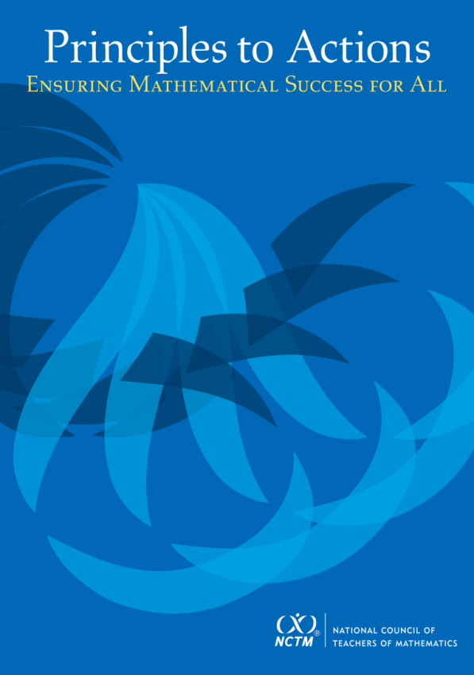
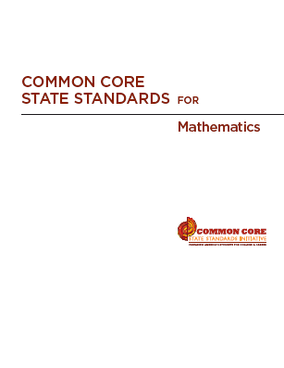
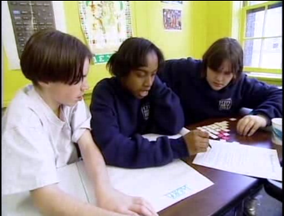
High Quality Standards Are Necessary, but Insufficient, for Effective Teaching and Learning

Slide 13
Key Features of CCSS-M
Focus: Focus strongly where the standards focus.
Coherence: Think across grades, and link to major topics
Rigor: In major topics, pursue conceptual understanding, procedural skill and fluency, and application
Standards for Mathematical Practice

Slide 14
Key Features of CCSS-M
Focus: Focus strongly where the standards focus.
Coherence: Think across grades, and link to major topics
Rigor: In major topics, pursue conceptual understanding, procedural skill and fluency, and application
Standards for Mathematical Practice

Slide 15
Curriculum Standards,
Not Assessment Standards
Understand and apply properties of operations and the relationship between addition and subtraction. (1.OA)
3. Apply properties of operations as strategies to add and subtract. Examples: If 8 + 3 = 11 is known, then 3 + 8 = 11 is also known. (Commutative property of addition.) To add 2 + 6 + 4, the second two numbers can be added to make a ten, so 2 + 6 + 4 = 2 + 10 = 12. (Associative property of addition.)
4. Understand subtraction as an unknown-addend problem. For example, subtract 10 – 8 by finding the number that makes 10 when added to 8.

Slide 16
Curriculum Standards,
Not Assessment Standards
Define, evaluate, and compare functions. (8.F)
1. Understand that a function is a rule that assigns to each input exactly one output. The graph of a function is the set of ordered pairs consisting of an input and the corresponding output.

Slide 17
Why Focus on Understanding??
Understanding facilitates initial learning and retention.
Understanding supports appropriate application and transfer.

Slide 18
Key Features of CCSS-M
Focus: Focus strongly where the standards focus.
Coherence: Think across grades, and link to major topics
Rigor: In major topics, pursue conceptual understanding, procedural skill and fluency, and application
Standards for Mathematical Practice

Slide 19
Phil Daro, 2010
Notes:
19

Slide 20
Phil Daro, 2010
Notes:
20

Slide 21
Other “Butterflies”?
FOIL
Cross multiplication
Division of fractions: Keep-change-flip, KFC, etc.
a ─ b = a + ⁻b: Keep-change-change
Key words
Division algorithm: Does McDonalds Sell Cheese Burgers?

Slide 22
Key Instructional Shift
From emphasis on:
How to get answers
To emphasis on:
Understanding mathematics

Slide 23
Key Features of CCSS-M
Focus: Focus strongly where the standards focus.
Coherence: Think across grades, and link to major topics
Rigor: In major topics, pursue conceptual understanding, procedural skill and fluency, and application
Standards for Mathematical Practice

Slide 24
Key Features of CCSS-M
Focus: Focus strongly where the standards focus.
Coherence: Think across grades, and link to major topics
Rigor: In major topics, pursue conceptual understanding, procedural skill and fluency, and application
Standards for Mathematical Practice

Slide 25
Standards for Mathematical Practice
  Make sense of problems and persevere in solving them.
  Reason abstractly and quantitatively.
  Construct viable arguments and critique the reasoning of others.
  Model with mathematics.
  Use appropriate tools strategically.
  Attend to precision.
  Look for and make use of structure.
  Look for and express regularity in repeated reasoning.

Slide 26
Implementing CCSS-M Requires
Instructional practices that promote students’ development of conceptual understanding and proficiency in the Standards for Mathematical Practice.

Slide 27
We Must Focus on Instruction
Student learning of mathematics “depends fundamentally on what happens inside the classroom as teachers and learners interact over the curriculum.”
(Ball & Forzani, 2011, p. 17)
“Teaching has 6 to 10 times as much impact on achievement as all other factors combined ... Just three years of effective teaching accounts on average for an improvement of 35 to 50 percentile points.”
Schmoker (2006, p.9)

Slide 28
Principles to Actions:
Ensuring Mathematical Success for All
  Describes the supportive conditions, structures, and policies required to give all students the power of mathematics
  Focuses on teaching and
  learning
  Emphasizes engaging students
  in mathematical thinking
  Describes how to ensure that
  mathematics achievement is maximized for every student
  Is not specific to any standards; it’s universal

Slide 29
Guiding Principles
for School Mathematics
Teaching and Learning
Effective teaching is the non-negotiable core that ensures that all students learn mathematics at high levels.

Slide 30
Guiding Principles
for School Mathematics
Teaching and Learning
Access and Equity
Curriculum
Tools and Technology
Assessment
Professionalism
Essential Elements
of Effective Math
Programs

Slide 31
Guiding Principles
for School Mathematics
Teaching and Learning
Access and Equity
Curriculum
Tools and Technology
Assessment
Professionalism

Slide 32

Beliefs About
Teaching and Learning?
What beliefs about teaching and learning might hinder effective teaching and learning?
What beliefs about teaching and learning might support effective teaching and learning?
Notes:
Provide handout

Slide 33
Unproductive vs Productive
Beliefs about Teaching and Learning
Beliefs should not be viewed as good or bad.
Beliefs are unproductive when they hinder implementation of effective instructional practice or limit student access to important mathematics content and practices.
Notes:
Provide handout

Slide 34
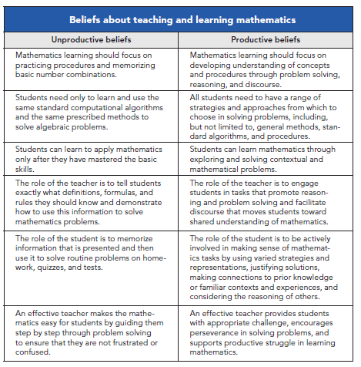
p. 11

Slide 35
Candy Jar Problem
A candy jar contains 5 Jolly Ranchers (squares) and 13 Jawbreakers (circles). Suppose you had a new candy jar with the same ratio of Jolly Ranchers to Jawbreakers, but it contained 100 Jolly Ranchers. How many Jawbreakers would you have? Explain how you know.
Please work this problem as if you were a seventh grader.
When done, share your work with a neighbor.
Discuss:
What mathematics learning could this task support?

Slide 36
Candy Jar Task
Common Core State Standards 7.RP:
2. Recognize and represent proportional relationships between quantities.
Decide whether two quantities are in a proportional relationship, e.g., by testing for equivalent ratios in a table or graphing on a coordinate plane and observing whether the graph is a straight line through the origin.
Identify the constant of proportionality (unit rate) in tables, graphs, equations, diagrams, and verbal descriptions of proportional relationships.
Represent proportional relationships by equations. For example, if total cost t is proportional to the number n of items purchased at a constant price p, the relationship between the total cost and the number of items can be expressed as t = pn.
Explain what a point (x, y) on the graph of a proportional relationship means in terms of the situation, with special attention to the points (0, 0) and (1, r) where r is the unit rate.

Slide 37
Standards for Mathematical Practice
  Make sense of problems and persevere in solving them.
  Reason abstractly and quantitatively.
  Construct viable arguments and critique the reasoning of others.
  Model with mathematics.
  Use appropriate tools strategically.
  Attend to precision.
  Look for and make use of structure.
  Look for and express regularity in repeated reasoning.

Slide 38
The Case of Mr. Donnelly
Read the Case of Mr. Donnelly and study the strategies used by his students.
Make note of what Mr. Donnelly did before or during instruction to support his students’ learning and understanding of proportional relationships.
Talk with a neighbor about the actions and interactions that you identified as supporting student learning.

Slide 39
Principle on Teaching and Learning
An excellent mathematics program requires effective teaching that engages students in meaningful learning through individual and collaborative experiences that promote their ability to make sense of mathematical ideas and reason mathematically.

Slide 40
Effective
Mathematics Teaching Practices
Establish mathematics goals to focus learning.
Implement tasks that promote reasoning and problem solving.
Use and connect mathematical representations.
Facilitate meaningful mathematical discourse.
Pose purposeful questions.
Build procedural fluency from conceptual understanding.
Support productive struggle in learning mathematics.
Elicit and use evidence of student thinking.

Slide 41
Establish Mathematics Goals
To Focus Learning
Learning Goals should:
Clearly state what it is students are to learn and understand about mathematics as the result of instruction;
Be situated within learning progressions; and
Frame the decisions that teachers make during a lesson.
Formulating clear, explicit learning goals sets the stage for everything else.
(Hiebert, Morris, Berk, & Janssen, 2007, p.57)

Slide 42
Candy Jar Task
Common Core State Standards 7.RP:
2. Recognize and represent proportional relationships between quantities.
Decide whether two quantities are in a proportional relationship, e.g., by testing for equivalent ratios in a table or graphing on a coordinate plane and observing whether the graph is a straight line through the origin.
Identify the constant of proportionality (unit rate) in tables, graphs, equations, diagrams, and verbal descriptions of proportional relationships.
Represent proportional relationships by equations. For example, if total cost t is proportional to the number n of items purchased at a constant price p, the relationship between the total cost and the number of items can be expressed as t = pn.
Explain what a point (x, y) on the graph of a proportional relationship means in terms of the situation, with special attention to the points (0, 0) and (1, r) where r is the unit rate.

Slide 43
Goals to Focus Learning
Mr. Donnelly’s goal for students’ learning:
Students will recognize that quantities that are in a proportional (multiplicative) relationship grow at a constant rate and that there are three key strategies that could be used to solve problems of this type – scaling up, scale factor, and unit rate.
How does his goal align with this next teaching practice?

Slide 44
Implement Tasks that Promote
Reasoning and Problem Solving
Mathematical tasks should:
Provide opportunities for students to engage in exploration or encourage students to use procedures in ways that are connected to concepts and understanding;
Build on students’ current understanding; and
Have multiple entry points.

Slide 45
Why Tasks Matter
Tasks form the basis for students’ opportunities to learn what mathematics is and how one does it;
Tasks influence learners by directing their attention to particular aspects of content and by specifying ways to process information;
The level and kind of thinking required by mathematical instructional tasks influences what students learn; and
Differences in the level and kind of thinking of tasks used by different teachers, schools, and districts, is a major source of inequity in students’ opportunities to learn mathematics.

Slide 46
Why Tasks Matter
Tasks form the basis for students’ opportunities to learn what mathematics is and how one does it;
Tasks influence learners by directing their attention to particular aspects of content and by specifying ways to process information;
The level and kind of thinking required by mathematical instructional tasks influences what students learn; and
Differences in the level and kind of thinking of tasks used by different teachers, schools, and districts, is a major source of inequity in students’ opportunities to learn mathematics.

Slide 47






Comparing Tasks
Finding the Missing Value
Find the value of the unknown in each of the proportions shown below.
How is Mr. Donnelly’s task (Candy Jar) similar to or different from the Missing Value problem?
Which one is more likely to promote problem solving?
Notes:
2 minutes to turn and talk
Same
Content
Both could be solved using cross multiplication
Different
Multiple ways to enter Candy Jar – picture, build model, make table
Multiple ways to solve CJ – scale factor, scaling up, unit rate
No implied way of solving CJ
Where the task could be used – beginning of a unit vs practicing a procedure
CJ has the potential to promote problem solving. The context also helps students in making sense of what the numbers they come up with actually mean.

Slide 48
Higher-Level Tasks
Doing mathematics
  Candy Jar task
Procedures with connections
  Using a 10 x 10 grid, identify the decimal and percent equivalents of 3/5.
  Explain how the graph of y = -3x² + 7 compares to the graph of y = x². Sketch the graph of y = -3x² + 7.
  Smith & Stein, 1998

Slide 49
Lower-Level Tasks
Memorization
  What are the decimal equivalents for the fractions ½ and ¼?
Procedures without connections
  Write the fraction 3/8 as a decimal.
  A rectangular carpet is 12 feet long and 9 feet wide. What is the area of the carpet in square feet?
  Smith & Stein, 1998

Slide 50
Task Analysis Guide
Notes:
Handout- TaskAnalysisGuide
The key feature of this task that makes it DOING MATHEMATICS is the fact that there is no predictable, well-rehearsed pathway available for solving the task. While most of the other characteristics are also applicable, it is this feature that distinguishes it from all other task types.
It is important to note, however, that IF students have already been taught the cross multiplication algorithm and have had opportunities to use it, then this task would be classified as procedures without connections.

Slide 51
Core Instructional Issue
Do all students have the opportunity to engage in mathematical tasks that promote students’ attainment of the mathematical practices on a regular basis?

Slide 52
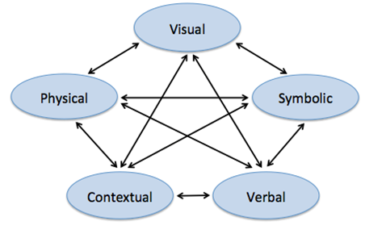
Use and Connect
Mathematical Representations
Different Representations should:
Be introduced, discussed, and connected;
Focus students’ attention on the structure or essential features of mathematical ideas; and
Support students’ ability to justify and explain their reasoning.
Strengthening the ability to move between and among these representations improves the growth of children’s concepts.
Lesh, Post, Behr, 1987

Slide 53
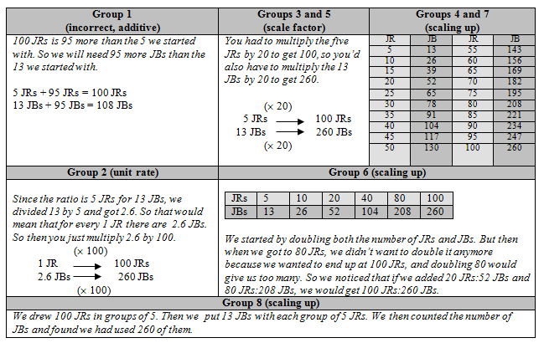
How did Mr. Donnelly use these different representations to support students’ learning?

Slide 54
Facilitate
Meaningful Mathematical Discourse
Mathematical Discourse should:
Build on and honor students’ thinking;
Provide students with the opportunity to share ideas, clarify understandings, and develop convincing arguments; and
Advance the mathematical learning of the whole class.

Slide 55
Facilitate
Meaningful Mathematical Discourse
Discussions that focus on cognitively challenging mathematical tasks, namely those that promote thinking, reasoning, and problem solving, are a primary mechanism for promoting conceptual understanding of mathematics (Hatano & Inagaki, 1991; Michaels, O’Connor, & Resnick, 2008).
Smith, Hughes, Engle & Stein, 2009, p. 549

Slide 56
Meaningful Discourse
What did Mr. Donnelly do (before or during the discussion) that may have positioned him to engage his students in a productive discussion?

Slide 57
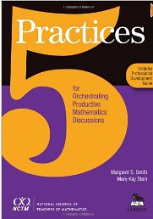
Five Practices for Orchestrating Productive Discussions
Anticipating likely student responses
Monitoring students’ actual responses
Selecting particular students to present their mathematical work during the whole class discussion
Sequencing the student responses
Connecting different students’ responses—to each other and to key mathematical ideas.
Smith & Stein, 2011

Slide 58
Planning with the Student in Mind
Anticipate solutions, thoughts, and responses that students might develop as they struggle with the problem
Generate questions that could be asked to promote student thinking during the lesson, and consider the kinds of guidance that could be given to students who showed one or another types of misconception in their thinking
Determine how to end the lesson so as to advance students’ understanding
  Stigler & Hiebert, 1997

Slide 59
Pose Purposeful Questions
Effective Questions should:
Reveal students’ current understandings;
Encourage students to explain, elaborate, or clarify their thinking; and
Make the mathematics more visible and accessible for student examination and discussion.

Slide 60
Pose Purposeful Questions
Can someone tell me or share with me another way?
Do you think that means the same things?
Is there another opinion about this?
Why did you say that, Justin?
How did you get that?
How do you know that?
Can you explain your idea?
Why?
Can you convince us?
Did anyone get something
else?
Boaler, J., & Brodie, K. (2004)

Slide 61
Build Procedural Fluency from Conceptual Understanding
Procedural Fluency should:
Build on a foundation of conceptual understanding;
Result in generalized methods for solving problems; and
Enable students to flexibly choose among methods to solve contextual and mathematical problems.

Slide 62
Build Procedural Fluency from Conceptual Understanding
Students must be able to do much more than carry out mathematical procedures. They must know which procedure is appropriate and most productive in a given situation, what a procedure accomplishes, and what kind of results to expect. Mechanical execution of procedures without understanding their mathematical basis often leads to bizarre results.
Martin, 2009, p. 165

Slide 63

Procedural Fluency
What might we expect the students in Mr. Donnelly’s class to be able to do when presented with a missing value problem, after they have had the opportunity to develop a set of strategies through solving a variety of contextual problems like the Candy Jar Task?

Slide 64
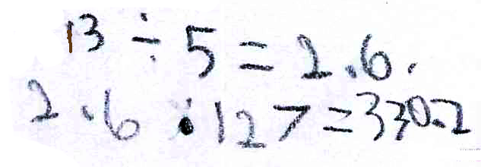
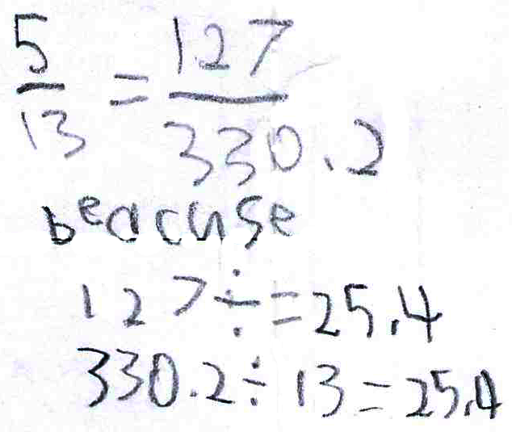
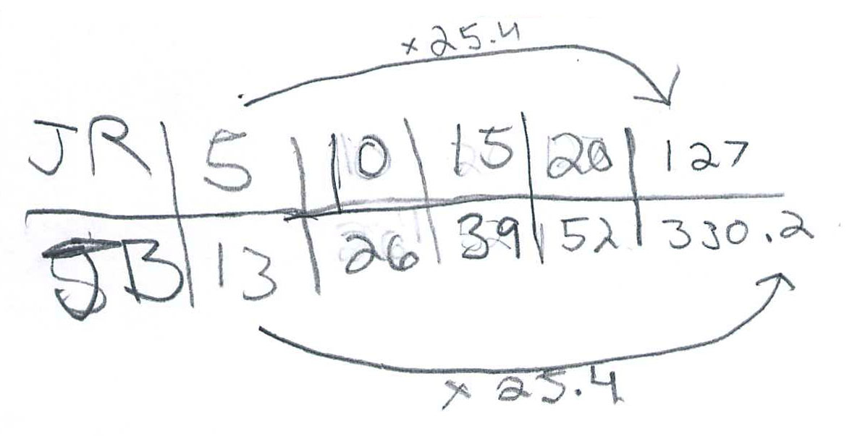
Procedural Fluency

Slide 65
Procedural Fluency
Unit Rate
Scale Factor
Scaling Up

Slide 66
Building Procedural Fluency from Conceptual Understanding
Finding the Missing Value
Find the value of the unknown in each of the proportions shown below.
Notes:
2 minutes to turn and talk
Same
Content
Both could be solved using cross multiplication
Different
Multiple ways to enter Candy Jar – picture, build model, make table
Multiple ways to solve CJ – scale factor, scaling up, unit rate
No implied way of solving CJ
Where the task could be used – beginning of a unit vs practicing a procedure
CJ has the potential to promote problem solving. The context also helps students in making sense of what the numbers they come up with actually mean.

Slide 67
Support Productive Struggle
in Learning Mathematics
Productive Struggle should:
Be considered essential to learning mathematics with understanding;
Develop students’ capacity to persevere in the face of challenge; and
Help students realize that they are capable of doing well in mathematics with effort.

Slide 68
Support Productive Struggle in Learning Mathematics
The struggle we have in mind comes from solving problems that are within reach and grappling with key mathematical ideas that are comprehendible but not yet well formed
Hiebert et al., 1996
By struggling with important mathematics we mean the opposite of simply being presented information to be memorized or being asked only to practice what has been demonstrated.
Hiebert & Grouws, 2007, pp. 387-388
Notes:
Not talking about giving students impossible problems to.
CLICK ON QUOTE
Students need to be able to figure things out for themselves…it is through this process of figuring things own that they will develop authority and ownership of their own learning.

Slide 69
Productive Struggle
How did Mr. Donnelly support students when they struggled?
What would have happened if he had been more directive with his students?

Slide 70
Elicit and Use Evidence
of Student Thinking
Evidence should:
Provide a window into students’ thinking;
Help the teacher determine the extent to which students are reaching the math learning goals; and
Be used to make instructional decisions during the lesson and to prepare for subsequent lessons.

Slide 71
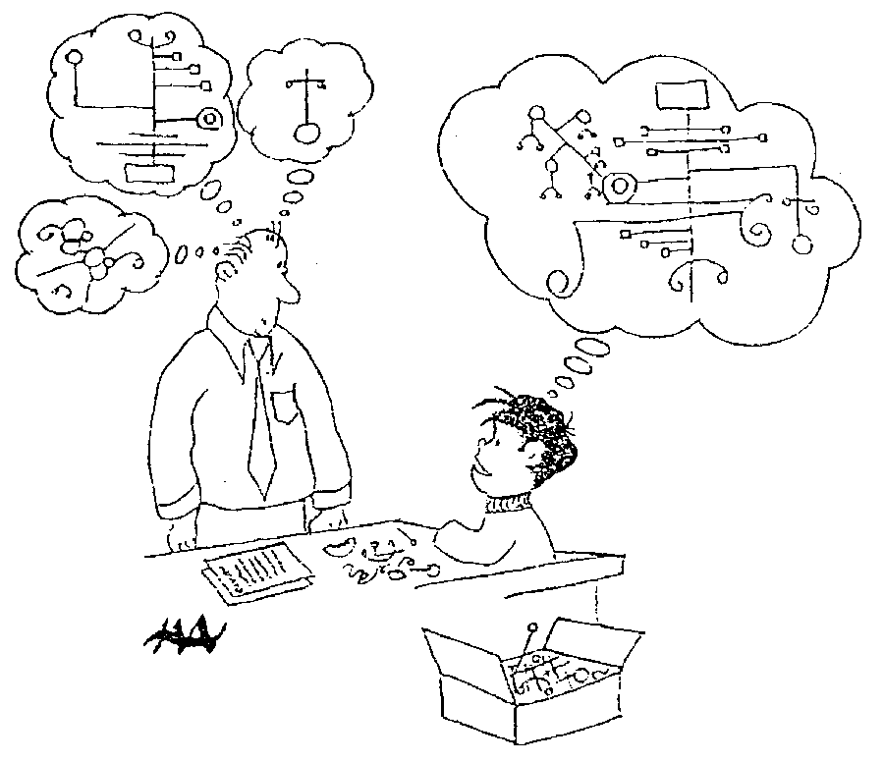
Harold Asturias, 1996
Notes:
This cartoon illustrates what assessment is really about.
Each student develops some concept of mathematics is. Our jobs as teachers and administrators is to figure out what is going on in our students heads.
What do they really understand about mathematics? Unfortunately we can’t just open up the kid’s head and look.
We are restricted to look at visible and tangible evidence---what they say and do. In classrooms, we have a wide variety of evidence available for us.
At the district level, we are often stuck with what kids actually do, often on on-demand types of test.
A critical question is how good are our inferences? To what extent are we actually developing a accurate perception of what kids actually know?
This is what we are call valid inferences. We are making inferences of what children know when our idea of what they know matches, as well as possible, to what they actually understand. We never want to assume that they know something that they don’t, and we also don’t want to assume that they don’t know something that they do.

Slide 72
Formative assessment is an essentially interactive process, in which the teacher can find out whether what has been taught has been learned, and if not, to do something about it. Day-to-day formative assessment is one of the most powerful ways of improving learning in the mathematics classroom.
Wiliam, 2007, pp. 1054; 1091

Slide 73
Effective
Mathematics Teaching Practices
Establish mathematics goals to focus learning.
Implement tasks that promote reasoning and problem solving.
Use and connect mathematical representations.
Facilitate meaningful mathematical discourse.
Pose purposeful questions.
Build procedural fluency from conceptual understanding.
Support productive struggle in learning mathematics.
Elicit and use evidence of student thinking.

Slide 74
Digging Deeper into the Effective Teaching practices

Slide 75
Effective
Mathematics Teaching Practices
Establish mathematics goals to focus learning.
Implement tasks that promote reasoning and problem solving.
Use and connect mathematical representations.
Facilitate meaningful mathematical discourse.
Pose purposeful questions.
Build procedural fluency from conceptual understanding.
Support productive struggle in learning mathematics.
Elicit and use evidence of student thinking.

Slide 76
Implement Tasks that Promote
Reasoning and Problem Solving
Mathematical tasks should:
Provide opportunities for students to engage in exploration or encourage students to use procedures in ways that are connected to concepts and understanding;
Build on students’ current understanding; and
Have multiple entry points.

Slide 77
Graphing Dice Throws

Slide 78
Graphing Dice Throws

Slide 79
Graphing Dice Throws

Slide 80
Graphing Dice Throws

Slide 81
Graphing Dice Throws

Slide 82
Graphing Dice Throws
“My children are “low level”,
so I do the activity using 1 die.”

Slide 83
Graphing Dice Throws

Slide 84
Graphing Dice Throws

Slide 85
The Implementation of the Task
Read the Case of Sandra Pascal. Compare it to the Case of Mr. Donnelly.
Consider:
How are the implementations in the two classrooms the same and how are they different?
Which of the effective teaching practices did each of the two teachers engage in?
In what ways did the use of the effective teaching practices support student learning?
  Be sure to use evidence from the case to support your claims.
Notes:
Handouts – NarrativeCase-Donnelly, NarrativeCase-Pascal, Similar and Different Chart
Key distinctions:
Donnelly
Mr. Donnelly supported students’ ability to work through the problem without taking over the thinking for them and thereby lowering the demand of the task. In this way he sent the message to students that they were capable of figuring it out for themselves. In the end they would have ownership of the work.
When students struggled, Mr. Donnelly encouraged students to look at the work they had done the previous day (lines 13-16).
The teacher asked questions as needed to help students make progress on the task (lines 10-15).
The teacher acknowledges and names a correct strategy – the marking serves as praise and signals a point in the lesson when the student can move forward (line 57-58).
The teacher concluded the lesson by asking students to make sense of the incorrect additive solution, indicating that the teacher did not tell students that this was wrong but left them with the tasking of figuring out why it would not work (lines 74-79).
Pascal
When students struggled, the teacher took over the thinking for them and told them exactly what to do. It is notable that when students first express that they are struggling, Pascal’s response is to direct them to a strategy as compared to asking questions that might assess what their current thinking might be, and to identify ways to advance that thinking. In the end students all got the same correct answer and used the same strategy – the one the teacher suggested. However, the strategy of building a table is not one that is efficient once numbers get large. As a results students were not building a set of approaches that would apply to a broad class of problems. While this strategy may have met the immediate demand of getting students to a correct answer, it is worth considering whether this was Ms. Pascal’s instructional goal, or whether the goal was for students to develop a broader understanding of how proportional relationships work.

Slide 86
Effective
Mathematics Teaching Practices
Establish mathematics goals to focus learning.
Implement tasks that promote reasoning and problem solving.
Use and connect mathematical representations.
Facilitate meaningful mathematical discourse.
Pose purposeful questions.
Build procedural fluency from conceptual understanding.
Support productive struggle in learning mathematics.
Elicit and use evidence of student thinking.

Slide 87
Implement Tasks that Promote Reasoning and Problem Solving
Although selecting tasks that promote reasoning and problem solving is a critical first step, giving the task to students does not guarantee that students will actually engage in the task at a high level.
NCTM, 2014, p.22

Slide 88
The Mathematical Tasks Framework
Tasks as
enacted by
teachers and
students
Tasks as
they appear
in curricular
materials
Tasks as
set up by
teachers
Student
learning
Stein, Grover & Henningsen (1996)
Smith & Stein (1998)
Stein, Smith, Henningsen & Silver (2000)
Notes:
Having good tasks is only part of the story, how a teacher uses the task can significantly impact students’ learning
opportunity
Tasks are important, but teachers also matter!
Teacher actions and reactions, that is their instructional decisions in the classroom, …
influence the nature and extent of student engagement with challenging tasks,
and
effect students’ opportunities to learn from and through task engagement. In particular, the way teachers choose to use tasks can significantly influence the opportunities students have to develop skills associated with the mathematical practices.

Slide 89
Mathematical Tasks and
Student Learning
Students who performed the best on project-based measures of reasoning and problem solving were in classrooms in which tasks were more likely to be set up and enacted at high levels of cognitive demand.
Stein & Lane, 1996; Stein, Lane, & Silver, 1996
Notes:
Several studies provide evidence that cognitive demands are related to student learning.

Slide 90
NSF Local System Change Project Evaluation Study
While teachers were using the materials more extensively in their classrooms, there was a wide variation in how well they were implementing these materials. Teachers were often content to omit rich activities, skip over steps and jump to higher level concepts, or leave little time for students to ‘make sense’ of the lessons.
Weiss, et al, 2006

Slide 91
NSF Local System Change Project Evaluation Study
In fact, classroom observations indicated that the lessons taught as the developers intended were more likely to provide students with learning opportunities than those that were “adapted.”
Weiss, et al, 2006

Slide 92
Types of Math Problems Presented
1999 TIMSS Video Study

Slide 93
How Teachers Implemented Making Connections Math Problems

Slide 94
Teacher Actions that Affect Cognitive Demand
Task set-up
Supporting students’ exploration of the task
Orchestrating debriefing discussion

Slide 95

The Case of Jeff Ziegler
High School
Effective Mathematics Teaching Practices
Developed by Margaret Smith and Victoria Bill at the University of Pittsburgh. Video courtesy of Pittsburgh Public Schools and the Institute for Learning.
Notes:
This session focuses on Productive Struggle. It is suggested that teachers have some familiarity with the Effective Teaching Practices prior to engaging in this session.
There are two sessions available that provide an overview of the Teaching and Learning Principle, with some discussion of each of the effective teaching practices http://www.nctm.org/PrinciplestoActions/ .-- The Candy Jar (middle school content) or the Pay It Forward (high school content).

Slide 96
The S Pattern Task¹
1
2
3
4
5
    1. What patterns do you notice in the set of figures?
    2. How many square tiles are in figure 7? Write a description that could be used to determine the shape of and total number of square tiles in figure 7. Your description should be clear enough so that another person could read it and use it to think about another figure.
    3. Determine an equation for the total number of squares in any figure. Explain your rule and show how it relates to the visual diagram of the figures.
    4. Find a second way to describe the pattern and write the equation that matches the description. Compare the two equations and show in the visual representation how one equation is equivalent to the other.
    5. If you knew that a figure had 9802 squares tiles in it, how could you determine the figure number? Explain.
    Does the pattern describe a linear relationship between the figure number and the total number of squares? Why or why not?
¹This task was adapted from Visual Mathematics Course II, Lessons 1-10 published by The Math Learning Center, Salem, OR.
Notes:
The video clips featured in this session feature students who are trying to write equations for the total number of squares in any figure and relate the equations they create to the physical arrangement of tiles in the figures (Step 3) .
It is suggested that you engage teachers in solving the task prior to analyzing the video. This will take 45-60 minutes. The lesson guide (8. Calling Plans-LESSON GUIDE) contains suggestions for conducting the lesson and sample solutions that may be helpful to you.
If you don’t have time to engage teachers in the lesson, you should give the teachers several different forms of the function (shown below) and ask them to relate the function to the physical arrangement of tiles in the S-Pattern.
n-= total number of tiles
f= figure number
n= f² + 1
n= (f + 1)(f - 1) + 2
n= (f - 1)² + 2f
n= f(f+1) - (n-1)

Slide 97
The S-Pattern Task
Video Context
School: Langley High School, Pittsburgh Public Schools
Teacher: Mr. Jeffrey Ziegler
Principal: Linda Baehr
Class: 11th-12th Grade Students
At the time the video was filmed, Jeffery Ziegler was a coach at Langley High School in the Pittsburgh Public School District. The students are 11th and 12th grade and struggle with mathematics.
(Jeffrey Ziegler is currently a curriculum supervisor for grades 6-12 mathematics in the Pittsburgh Public School district.)

Slide 98
Mr. Ziegler’s
Mathematics Learning Goals
Students will understand that:
  An equation can be written that describes the relationship between 2 quantities;
  Different but equivalent equations can be written that represent the same situation; and
  The symbolic and pictorial representations can be connected.

Slide 99
Connections to the CCSS Content Standards
Creating Equations★ A-CED
Create equations that describe numbers or relationships.
2. Create equations in two or more variables to represent relationships between quantities; graph equations on coordinate axes with labels and scales.
National Governors Association Center for Best Practices & Council of Chief State School Officers. (2010). Common core state standards for mathematics. Washington, DC: Authors.

Slide 100
The S-Pattern Task
The Context of Video Clips
The lesson begins with Mr. Ziegler engaging students in a brief discussion of the task. They establish the fact that this was a growth pattern that is growing in two dimensions, getting both “taller” and “bigger”. Before they begin their work, Mr. Ziegler tells students:
“Now there are 6 prompts... Kind of the first one, the second one, third one is to kind of get you started but it is on you guys to work with your groups to come up with a way to find the patterns. You don’t necessarily have to word-for-word answer these questions, but they’re there to help you maybe get started.
The clip begins as small groups begin to work on the task and Mr. Ziegler visits Groups 1 and 2.

Slide 101
Lens for Watching the Video Clip 1
As you watch the video, make note of what the teacher does as he interacts with groups 1 and 2.
In particular, identify any of the Effective Mathematics Teaching Practices that you notice Mr. Ziegler using.
Be prepared to give examples and to cite line numbers from the transcript to support your claims.
Also, record any questions that you have (wonderings)
Notes:
Here are some of the things that teachers might notice:
He did not stand over students - he either sits at their table or kneels on the floor so he can make eye contact with them.
He did not tell students how to solve the task (in the case of group 1) and he did not indicate whether group 2 was correct or incorrect.
He asked questions to elicit student thinking regarding what they had done and what they understand about what they had done.
He pressed group 1 to try to find a way to find the total number of tiles in a figure without counting. He wanted them to focus on the shape of the figure and use the shape to find a more efficient way to count.
Although 1 student in group 2 could describe an equation for the total number of tiles, he pressed the other students in the group to explain it in terms of the picture.
He left both groups with something to think about -- he didn’t hover over them but rather left them to figure out what to do next
Teachers may identify goals, tasks, questions as effective teaching practices that were used. (See Ziegler Analysis notes for details.)
Teachers may not indicate that the Ziegler’s actions provide evidence of productive struggle. You might ask: Did the teacher support productive struggle? You can then proceed to talk about what productive struggle is. (The next slide will help.)

Slide 102
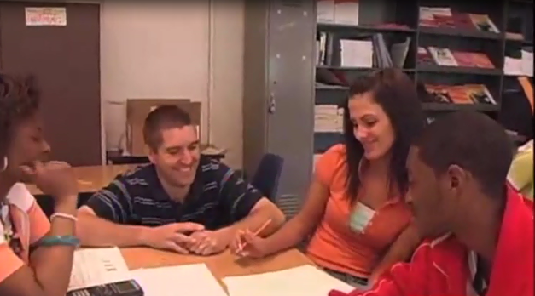
Video Clip 1
http://www.nctm.org/Conferences-and-Professional-Development/Principles-to-Actions-Toolkit/The-Case-of-Jeffrey-Ziegler-and-the-S-Pattern-Task/

Slide 103
Lens for Watching the Video Clip 1
As you watch the video, make note of what the teacher does as he interacts with groups 1 and 2.
In particular, identify any of the Effective Mathematics Teaching Practices that you notice Mr. Ziegler using.
Be prepared to give examples and to cite line numbers from the transcript to support your claims.
Notes:
Here are some of the things that teachers might notice:
He did not stand over students - he either sits at their table or kneels on the floor so he can make eye contact with them.
He did not tell students how to solve the task (in the case of group 1) and he did not indicate whether group 2 was correct or incorrect.
He asked questions to elicit student thinking regarding what they had done and what they understand about what they had done.
He pressed group 1 to try to find a way to find the total number of tiles in a figure without counting. He wanted them to focus on the shape of the figure and use the shape to find a more efficient way to count.
Although 1 student in group 2 could describe an equation for the total number of tiles, he pressed the other students in the group to explain it in terms of the picture.
He left both groups with something to think about -- he didn’t hover over them but rather left them to figure out what to do next
Teachers may identify goals, tasks, questions as effective teaching practices that were used. (See Ziegler Analysis notes for details.)
Teachers may not indicate that the Ziegler’s actions provide evidence of productive struggle. You might ask: Did the teacher support productive struggle? You can then proceed to talk about what productive struggle is. (The next slide will help.)

Slide 104
Support Productive Struggle
in Learning Mathematics
Productive Struggle should:
Be considered essential to learning mathematics with understanding;
Develop students’ capacity to persevere in the face of challenge; and
Help students realize that they are capable of doing well in mathematics with effort.

Slide 105

Lens for Watching the Video
Clip 2
In the second video clip Mr. Ziegler visits Groups 1 and 2 for a second time.
Considering the teacher’s actions and interactions with Groups 1 and 2 in both clips, identify what the teacher does to support his student’s productive struggle.
Notes:
HANDOUT 8-TanscriptClip2-HS-Ziegler
See accompanying notes (2. Ziegler Analysis Notes) to support the discussion of the teacher’s actions and interaction.

Slide 106
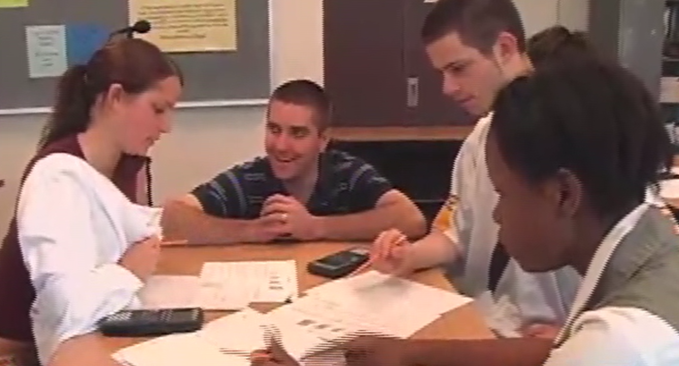
Video Clip 2
http://www.nctm.org/Conferences-and-Professional-Development/Principles-to-Actions-Toolkit/
The-Case-of-Jeffrey-Ziegler-and-the-S-Pattern-Task/

Slide 107
Lens for Watching the Video
Clip 2
In the second video clip Mr. Ziegler visits Groups 1 and 2 for a second time.
Considering the teacher’s actions and interactions with Groups 1 and 2 in both clips, identify what the teacher does to support his student’s productive struggle.
Notes:
HANDOUT 8-TanscriptClip2-HS-Ziegler
See accompanying notes (2. Ziegler Analysis Notes) to support the discussion of the teacher’s actions and interaction.

Slide 108
Effective
Mathematics Teaching Practices
Establish mathematics goals to focus learning.
Implement tasks that promote reasoning and problem solving.
Use and connect mathematical representations.
Facilitate meaningful mathematical discourse.
Pose purposeful questions.
Build procedural fluency from conceptual understanding.
Support productive struggle in learning mathematics.
Elicit and use evidence of student thinking.
Notes:
(This slide is animated. It provides a way of pulling together the ideas that are likely to surface in the discussion.)
Productive struggle can’t happen in isolation from the other practices. In these clips there is direct evidence of practices 2, 3, 5, and 8. Practice 1 can be inferred because we know what he goals were (see slide 5) and his questioning is clearly in service of the stated goals.
There is limited evidence of meaningful discourse here because of the nature of the clips -- we only can see what the groups are doing when the teachers is with them -- and we do not have access to what they did on their own or to the whole group discussion that took place later in the lesson.

Slide 109
Support Productive Struggle In Learning Mathematics:
Teacher and Student Actions
What are teachers doing?
Anticipating what students might struggle with during a lesson and being prepared to support them productively through the struggle.
Giving students time to struggle with tasks, and asking questions that scaffold students’ thinking without stepping in to do the work for them.
Helping students realize that confusion and errors are a natural part of learning, by facilitating discussions on mistakes, misconceptions, and struggles.
Praising students for their efforts in making sense of mathematical ideas and perseverance in reasoning through problems.
What are students doing?
Struggling at times with mathematics tasks but knowing that breakthroughs often emerge from confusion and struggle.
Asking questions that are related to the sources of their struggles and will help them make progress in understanding and solving tasks.
Persevering in solving problems and realizing that is acceptable to say, “I don’t know how to proceed here,” but it is not acceptable to give up.
Helping one another without telling their classmates what the answer is or how to solve the problem.
Notes:
The table shown in this slides summarizes teacher and student actions that embrace struggle as a natural aspect of learning.
You may want to distribute a copy of the teacher and student actions to facilitate teachers discussion/reflection related to the last slide.
HANDOUT 9-TeacherandStudent Actions-HS-Ziegler

Slide 110
Effective
Mathematics Teaching Practices
Establish mathematics goals to focus learning.
Implement tasks that promote reasoning and problem solving.
Use and connect mathematical representations.
Facilitate meaningful mathematical discourse.
Pose purposeful questions.
Build procedural fluency from conceptual understanding.
Support productive struggle in learning mathematics.
Elicit and use evidence of student thinking.

Slide 111
Reflection
What lessons can we learn from these classroom implementations?
What implications do they have for your work?
Notes:
The slides that follow provide some possible “lessons” that could be learned from these two implementations.

Slide 112
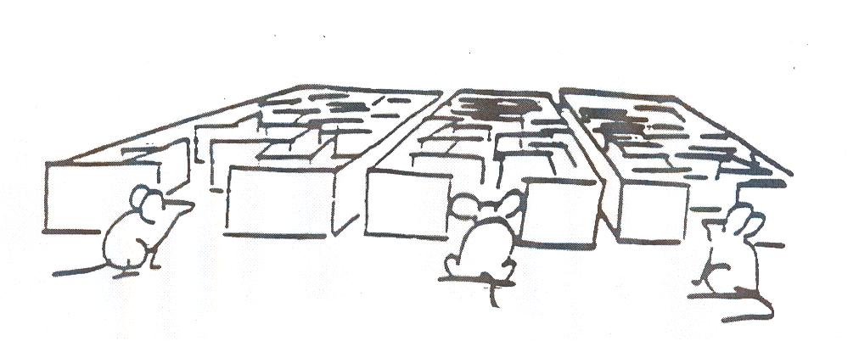
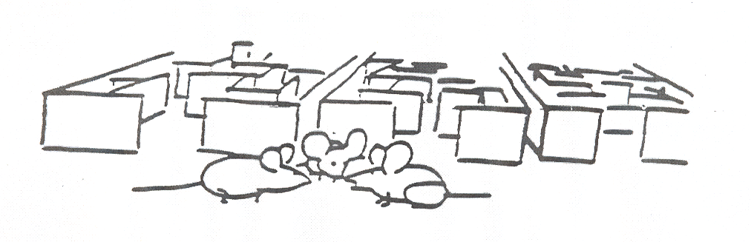
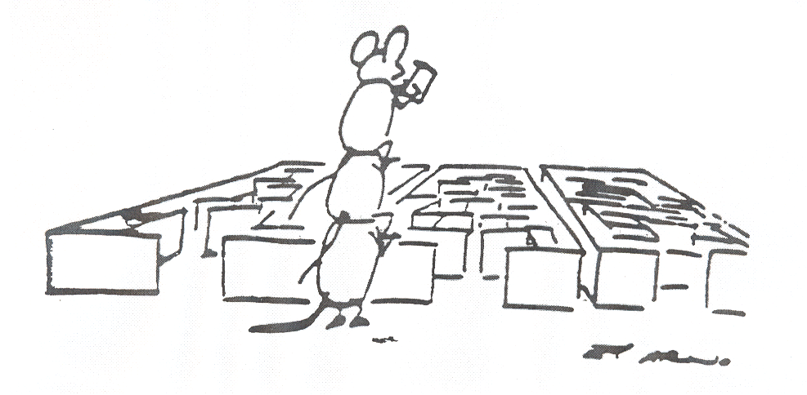

Slide 113
Guiding Principles
for School Mathematics
Teaching and Learning
Access and Equity
Curriculum
Tools and Technology
Assessment
Professionalism
Essential Elements
of Effective Math
Programs

Slide 114
Guiding Principles for School Mathematics
Professionalism
In an excellent mathematics program, educators hold themselves and their colleagues accountable for the mathematical success of every student and for their personal and collective professional growth toward effective teaching and learning of mathematics.

Slide 115
Guiding Principles for School Mathematics
Professionalism
In an excellent mathematics program, educators hold themselves and their colleagues accountable for the mathematical success of every student and for their personal and collective professional growth toward effective teaching and learning of mathematics.

Slide 116
Incremental Change
The social organization for improvement is a profession learning community organized around a specific instructional system.
A. S. Bryk (2009)
The unit of change is the teacher team.

Slide 117
Collaboration Team Work
An examination and prioritization of the mathematics content and mathematics practices students are to learn.
The development and use of common assessments to determine if students have learned the agreed-on content and related mathematical practices.
The use of data to drive continuous reflection and instructional decisions.
The setting of both long-term and short-term instructional goals.
Development of action plans to implement when students demonstrate they have or have not attained the standards.
Discussion, selection, and implementation of common research-informed instructional strategies and plans.
Principles to Actions, pp. 103-104

Slide 118
Collaboration Team Work
An examination and prioritization of the mathematics content and mathematics practices students are to learn.
The development and use of common assessments to determine if students have learned the agreed-on content and related mathematical practices.
The use of data to drive continuous reflection and instructional decisions.
The setting of both long-term and short-term instructional goals.
Development of action plans to implement when students demonstrate they have or have not attained the standards.
Discussion, selection, and implementation of common research-informed instructional strategies and plans.
Principles to Actions, pp. 103-104

Slide 119
Collaboration Team Work
An examination and prioritization of the mathematics content and mathematics practices students are to learn.
The development and use of common assessments to determine if students have learned the agreed-on content and related mathematical practices.
The use of data to drive continuous reflection and instructional decisions.
The setting of both long-term and short-term instructional goals.
Development of action plans to implement when students demonstrate they have or have not attained the standards.
Discussion, selection, and implementation of common research-informed instructional strategies and plans.
Principles to Actions, pp. 103-104

Slide 120
Start Small, Build Momentum, Persevere
The process of creating a new cultural norm characterized by professional collaboration, openness of practice, and continual learning and improvement can begin with a single team of grade level or subject-based mathematics teachers making the commitment to collaborate on a single lesson plan.
Principles to Actions, p. 207

Slide 121
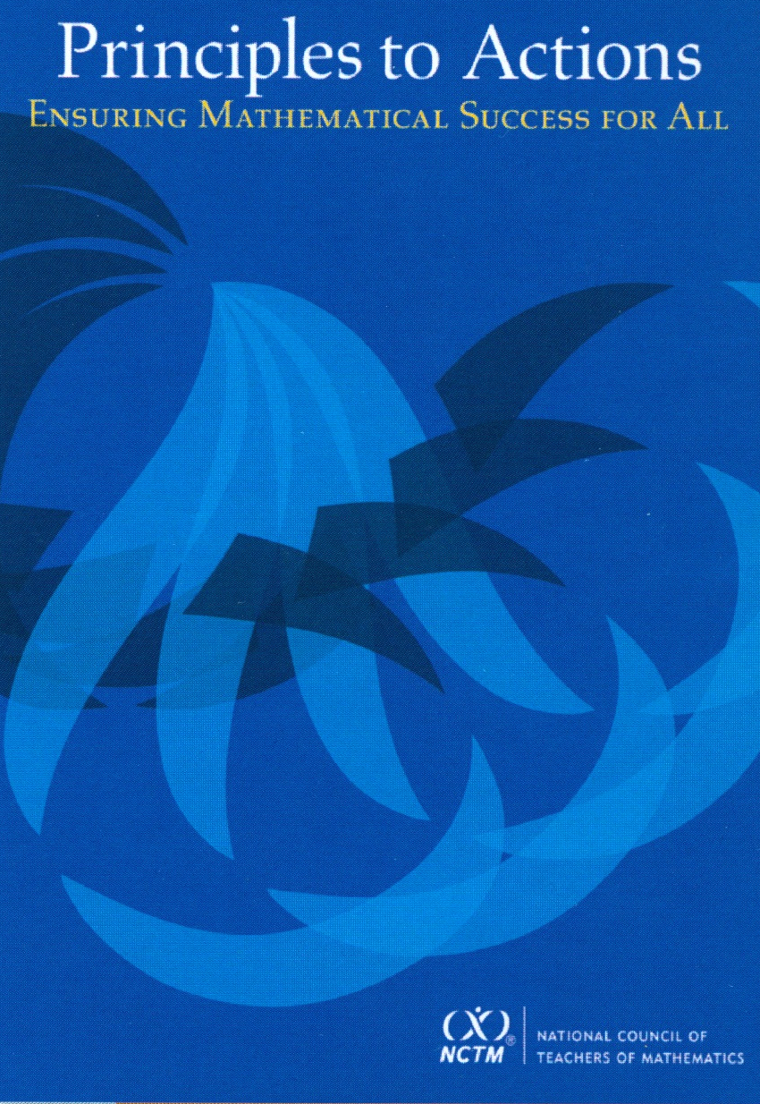
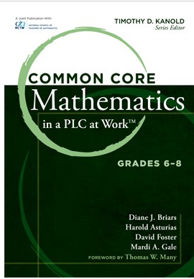
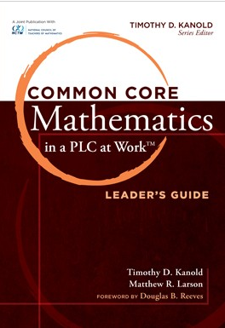
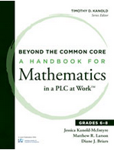
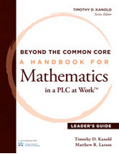
Collaborative Team Tools
Available at nctm.org

Slide 122
Principles to Actions:
Ensuring Mathematical Success for All
Teaching and Learning
Access and Equity
Curriculum
Tools and Technology
Assessment
Professionalism
Essential Elements
of Effective Math
Programs

Slide 123
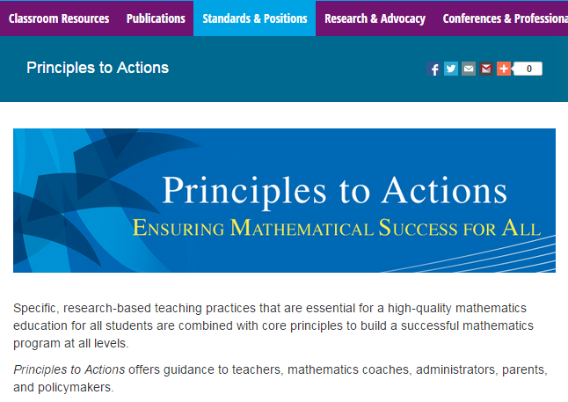
http://www.nctm.org/PtA/

Slide 124
Principles to Actions Resources
Principles to Actions Executive Summary
(in English and Spanish)
Principles to Actions overview presentation
Principles to Actions professional development guide (Reflection Guide)
Mathematics Teaching Practices presentations
  Elementary case, multiplication (Mr. Harris)
  Middle school case, proportional reasoning (Mr. Donnelly) (in English and Spanish)
  High school case, exponential functions (Ms. Culver)
Principles to Actions Spanish translation

Slide 125
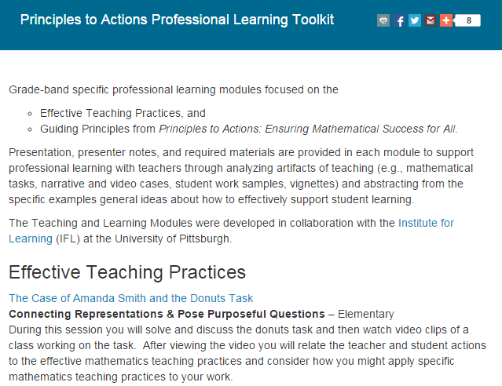
http://www.nctm.org/PtAToolkit/

Slide 126
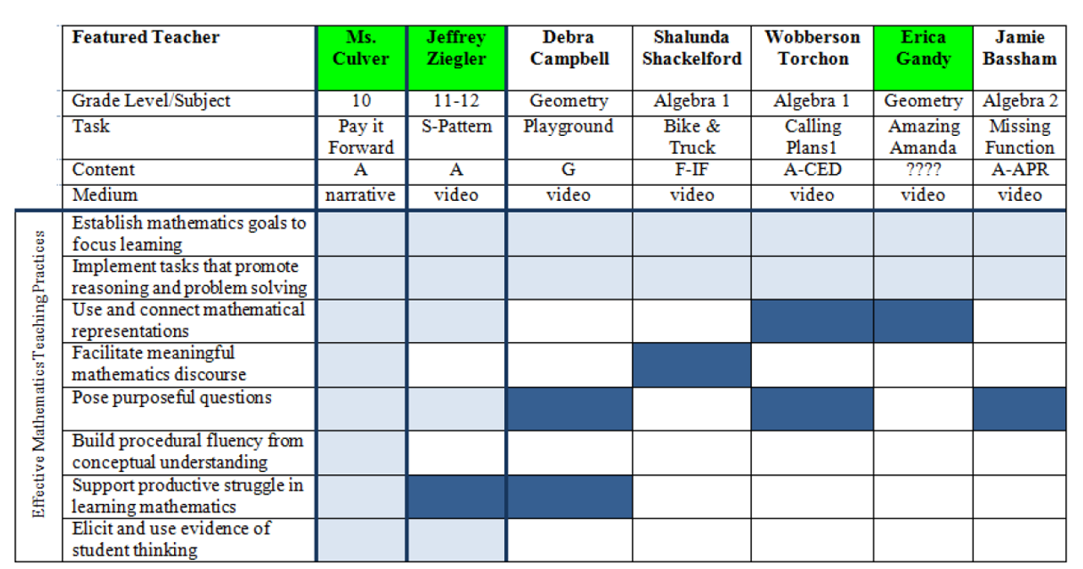
Principles to Actions
Effective Teaching Practices Toolkit
High School

Slide 127
  NCTM-Hunt Institute Video Series:
  Teaching and Learning Mathematics with the Common Core
    Enhance public understanding of what students need to know for college and career
    Why conceptual understanding requires a different approach
    Teachers, educators, leaders, and parents with classroom video
    Primarily for the public; useful to educator outreach

Slide 128

NCTM-Hunt Institute Video Series:
Teaching and Learning Mathematics with the Common Core
    Mathematics in the Early Grades
    Developing Mathematical Skills in Upper Elementary Grades
    Building Conceptual Understanding in Mathematics
    Mathematical Foundations for Success in Algebra
    Preparation for Higher Level Mathematics
    Parents: Supporting Mathematics Learning
    Standards for Mathematical Practice

Slide 129
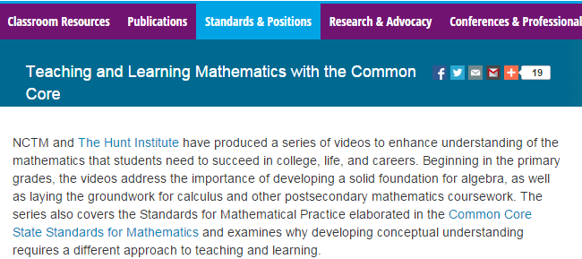
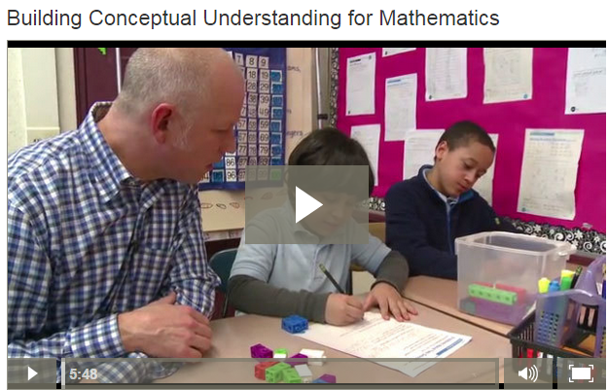
http://www.nctm.org/Standards-and-Positions/Common-Core-State-Standards/Teaching-and-Learning-Mathematics-with-the-Common-Core/

Slide 130
The Title Is Principles to Actions
Your Actions?

Slide 131
Thank You!
Diane Briars
dbriars@nctm.org

